Slide 1
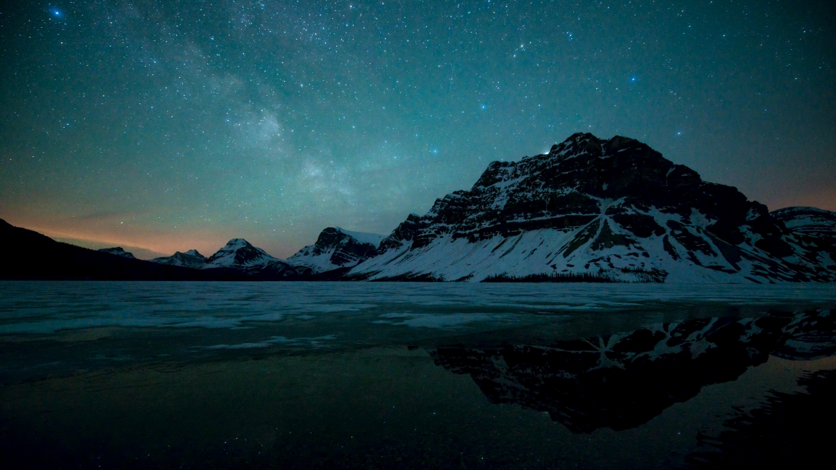
Derivation of Fourier Transform
& Image denoising application
Group3

Slide 2


CONTENT
1. Theoretical Derivation of FT
2. Application of FT
3. Result Analysis of Application
Notes:
And here is the content

Slide 3
01
PART
Theoretical Derivation

Slide 4
SUBTITLE
Derivation: Orthogonality of trigonometric functions
Derivation: Fourier Series
Derivation: Complex function $→$ Fourier Series
Reason: Discrete Fourier Transform
Reason: Fast Fourier Transform
Implementation: Fast Fourier Transform (2-dimension)
Notes:
The contain of this part can be separated into two parts, and the first half focus on derivation while the second part focus on Reason and implementation

Slide 5
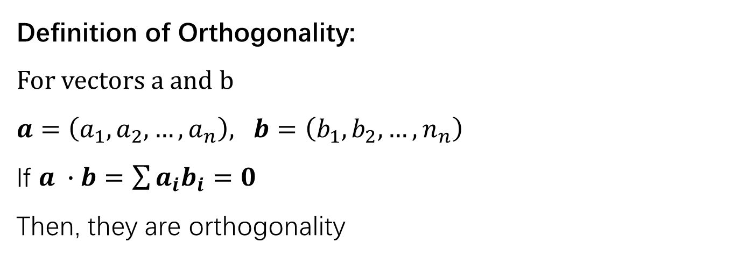
Orthogonality of trigonometric functions
Definition of Orthogonality:
For vectors a and b
$a=\left(a_{1},a_{2},…,a_{n}\right), b=\left(b_{1},b_{2},…,n_{n}\right)$
If $a ∙b=\sum{a_{i}b_{i}=0}$
Then, they are orthogonality
For trigonometric function, By using product to sum formular, we obtain:
$\int_{−π}^{π}{\cos{nx}\cos{mx}dx=}\int_{−π}^{π}{\frac{1}{2}[cos⁡[\left(n−m\right)x]+cos⁡[\left(n+m\right)x]]}$
$\frac{1}{2}×\frac{1}{n−m}\int_{−π}^{π}{ \sin{[\left(n−m\right)}x]dx}+\frac{1}{2}×\frac{1}{n+m}\int_{−π}^{π}{ sin[\left(n+m\right)x]dx}$
Since [$\sin{cx} ]$ is an odd function, the result of above expression is 0
Notes:
Firstly, we are going to prove the Orthogonality of trigonometric function,
If two vectors are orthogonal, then, the result of a dot b should equals to zero.
Hence, trigonometric functions have the property of orthogonality.

Slide 6
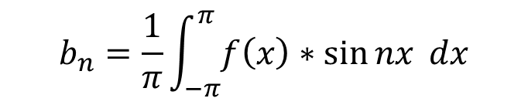
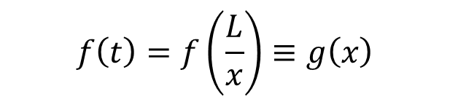
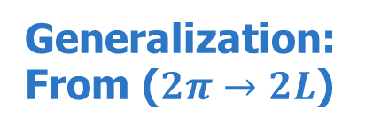
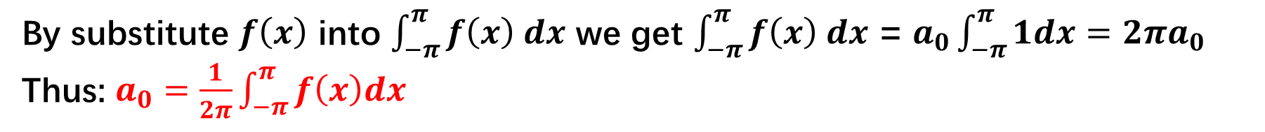
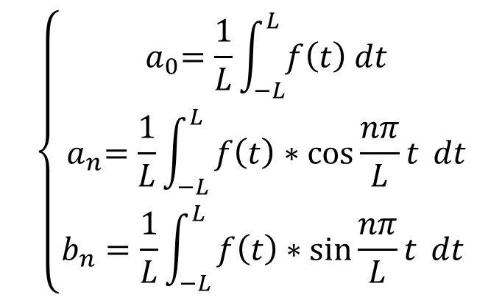
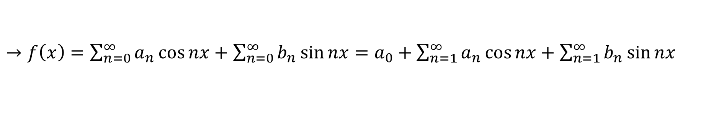
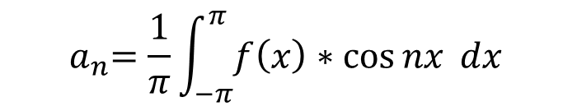

Derivation of Fourier Series
Assume we have a function: $f\left(x\right)=a_{0}+\sum_{n=0}^{∞}{c_{n}\cos{(nωt+φ)}}$
$→f\left(x\right)=\sum_{n=0}^{∞}{a_{n}\cos{nx}}+\sum_{n=0}^{∞}{b_{n}\sin{nx}}=a_{0}+\sum_{n=1}^{∞}{a_{n}\cos{nx}}+\sum_{n=1}^{∞}{b_{n}\sin{nx}}$
Thus, the Fourier series of a function is decided by $a_{n},b_{n},and a_{1}$
By substitute $f\left(x\right)$ into $\int_{−π}^{π}{f\left(x\right) dx}$ we get $\int_{−π}^{π}{f\left(x\right) dx}$ = $a_{0}\int_{−π}^{π}{1dx}=2πa_{0}$
Thus: $a_{0}=\frac{1}{2π}\int_{−π}^{π}{f\left(x\right)dx}$
Similarly:
$$\left\{\begin{aligned}{ a}_{0}=\frac{1}{L}\int_{−L}^{L}{f\left(t\right) dt} \\ { a}_{n}=\frac{1}{L}\int_{−L}^{L}{f\left(t\right)∗\cos{\frac{nπ}{L}t} dt} \\ b_{n}=\frac{1}{L}\int_{−L}^{L}{f\left(t\right)∗\sin{\frac{nπ}{L}t} dt}\end{aligned}\right.$$
$${ a}_{n}=\frac{1}{π}\int_{−π}^{π}{f\left(x\right)∗\cos{nx} dx}$$
Generalization:
From ($2π→2L$)
$$b_{n}=\frac{1}{π}\int_{−π}^{π}{f\left(x\right)∗\sin{nx} dx}$$
$$f\left(t\right)=f\left(\frac{L}{x}\right)≡g\left(x\right)$$
Notes:
Then, it comes to the derivation of Fourier Series. Initially, assume there is function …, by using product to sum formular, we are able to change it into this form.
Thus, the main task now become detect the value of a0, an, and bn. So, we substitute f(x) into …, and simplify the expression to get the results, which is one over 2pi times the integral of f(x).
Similarly, we can calculate the expression of an and bn.
And then, we try to extent the function from the period of 2pi to the more general form. And the corresponding result is this one.

Slide 7
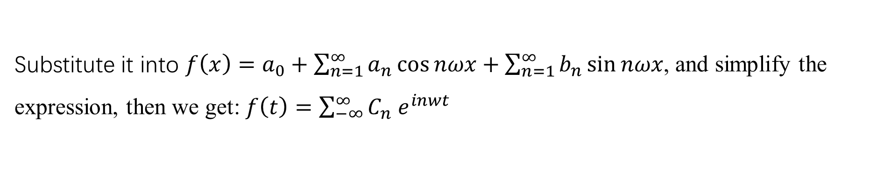
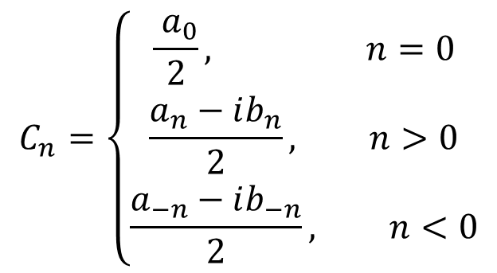
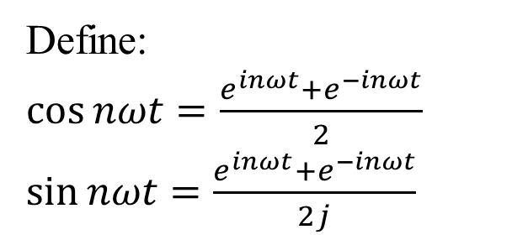
Complex function $→$ Fourier Series
Euler function: $e^{iθ}=\cos{θ}+i\sin{θ}$
Since: $θ=ωt=\frac{2π}{T}t$, we can rewrite the function as: $e^{iωt}=\cos{ωt}+i\sin{ωt}$
Define:
$\cos{nωt}=\frac{e^{inωt}+e^{−inωt}}{2}$
$\sin{nωt}=\frac{e^{inωt}+e^{−inωt}}{2j}$
$$C_{n}=\left\{\begin{aligned}\frac{{ a}_{0}}{2}, n=0 \\ \frac{a_{n}−ib_{n}}{2}, n>0 \\ \frac{a_{−n}−ib_{−n}}{2}, n<0\end{aligned}\right.$$
Substitute it into $f\left(x\right)=a_{0}+\sum_{n=1}^{∞}{a_{n}\cos{nωx}}+\sum_{n=1}^{∞}{b_{n}\sin{nωx}}$, and simplify the expression, then we get: $f\left(t\right)=\sum_{−∞}^{∞}{C_{n} e^{inwt}}$
Notes:
After obtaining the Fourier series, we are going to find the Fourier Series of complex function. First, we write down oula function. And since theta equals to omg t, we can rewrite the function as e to the power of I omg t equals to cos omgt + I times sin omg t.
And then, we define cos nwt and sin nwt in this form and Cn in this form. And then substitute it into f(x). After simplification, we got f(t) in this form.

Slide 8
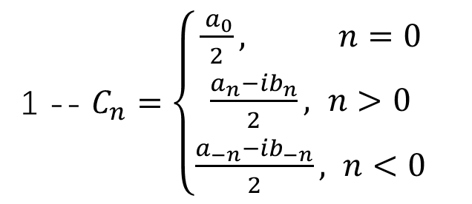
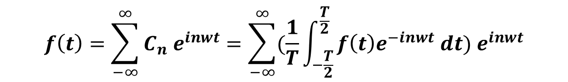
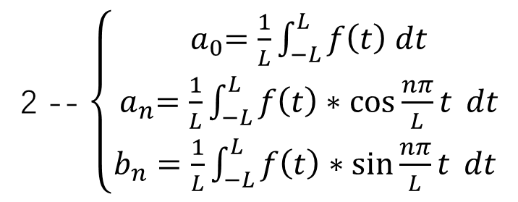
Complex function $→$ Fourier Series
1 -- $C_{n}=\left\{\begin{aligned}\frac{{ a}_{0}}{2}, n=0 \\ \frac{a_{n}−ib_{n}}{2}, n>0 \\ \frac{a_{−n}−ib_{−n}}{2}, n<0\end{aligned}\right.$
2 -- $\left\{\begin{aligned}{ a}_{0}=\frac{1}{L}\int_{−L}^{L}{f\left(t\right) dt} \\ { a}_{n}=\frac{1}{L}\int_{−L}^{L}{f\left(t\right)∗\cos{\frac{nπ}{L}t} dt} \\ b_{n}=\frac{1}{L}\int_{−L}^{L}{f\left(t\right)∗\sin{\frac{nπ}{L}t} dt}\end{aligned}\right.$
Removing punctuation
Combine 1 and 2, we got: $C_{n}=\frac{1}{T}\int_{−\frac{T}{2}}^{\frac{T}{2}}{f\left(t\right)e^{−inwt} dt}$
And then, the Fourier Series of Complex function is:
$$f\left(t\right)=\sum_{−∞}^{∞}{C_{n} e^{inwt}}=\sum_{−∞}^{∞}{(\frac{1}{T}\int_{−\frac{T}{2}}^{\frac{T}{2}}{f\left(t\right)e^{−inwt} dt}) e^{inwt}}$$
Notes:
Well, the last step is to combine these two result to get the expression of Cn. And then, The Fourier Series of complex function can be obtained.

Slide 9
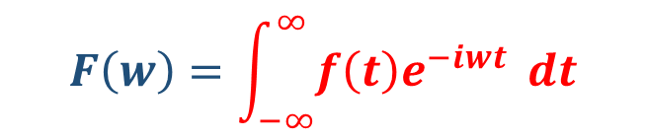

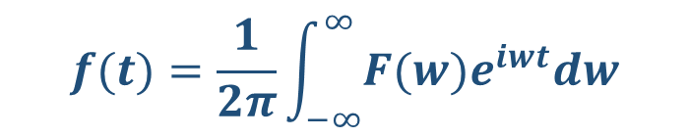
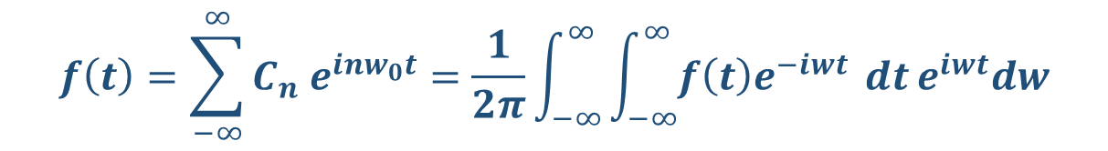
Complex function $→$ Fourier Series
Expandation: aperiodic ($2L→∞$)
$$f\left(t\right)=\sum_{−∞}^{∞}{C_{n} e^{inw_{0}t}}=\frac{1}{2π}\int_{−∞}^{∞}{\int_{−∞}^{∞}{f\left(t\right)e^{−iwt}} dt}e^{iwt}dw$$
$$F\left(w\right)=\int_{−∞}^{∞}{f\left(t\right)e^{−iwt}} dt$$
Fourier Transform
$$f(t)=\frac{1}{2π}\int_{−∞}^{∞}{F(w)e^{iwt}dw}$$
Inverse Fourier Transform
Notes:
After get the expression of Fourier series of complex function, the next step is to expand it to fit the aperiodic function.
Then we can sperate the whole expression into Fourier Transform and inverse Fourier Transform. By these expression, we are able to achieve the transformation of graph or voice signal.

Slide 10

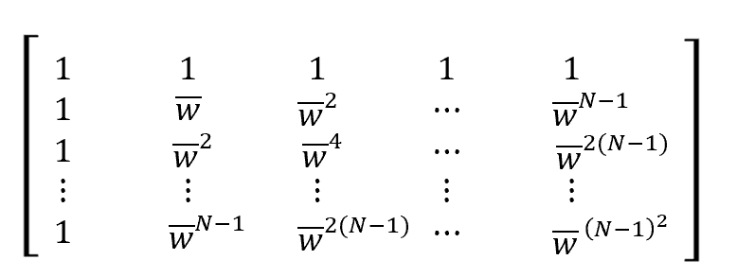
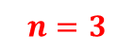
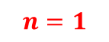
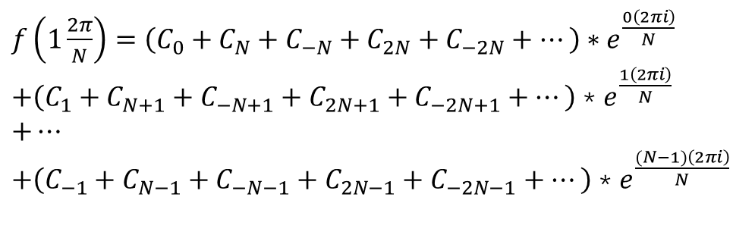
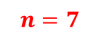
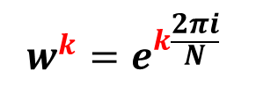
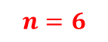
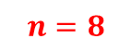
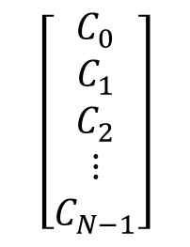
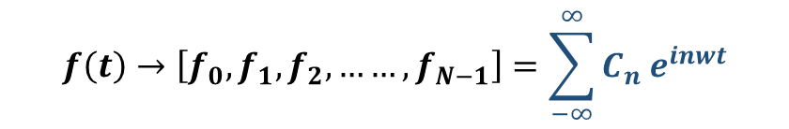
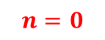
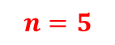
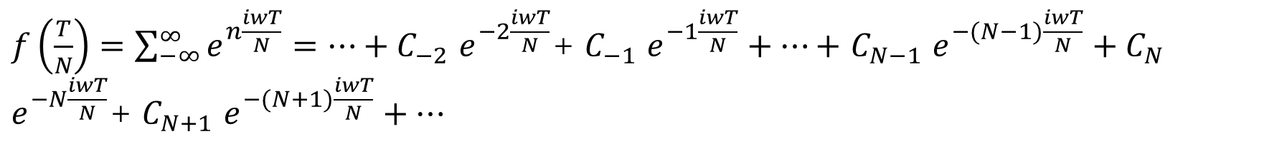
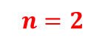
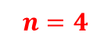

Discrete Fourier Transform (DFT)
For continuous Fourier transform, do equidistant N sampling within the period
$$f\left(t\right)→\left[f_{0},f_{1},f_{2},……, f_{N−1}\right]=\sum_{−∞}^{∞}{C_{n} e^{inwt}}$$
$f\left(\frac{T}{N}\right)=\sum_{−∞}^{∞}{e^{n\frac{iwT}{N}}}=…+C_{−2}$ $e^{−2\frac{iwT}{N}}$+ $C_{−1}$ $e^{−1\frac{iwT}{N}}+…+$ $C_{N−1}$ $e^{−(N−1)\frac{iwT}{N}}+C_{N} e^{−N\frac{iwT}{N}}$+ $C_{N+1}$ $e^{−(N+1)\frac{iwT}{N}}+…$
Property: for $e^{k\frac{iwT}{N}}$, A point returns to its original position after every cycle
$$w^{k}=e^{k\frac{2πi}{N}}$$
For $K=1:$
$$n=2$$
$f\left(1\frac{2π}{N}\right)=\left(C_{0}+C_{N}+C_{−N}+C_{2N}+C_{−2N}+…\right)∗e^{\frac{0\left(2πi\right)}{N}}$
$+\left(C_{1}+C_{N+1}+C_{−N+1}+C_{2N+1}+C_{−2N+1}+…\right)$ * $e^{\frac{1\left(2πi\right)}{N}}$
$+…$
$+\left(C_{−1}+C_{N−1}+C_{−N−1}+C_{2N−1}+C_{−2N−1}+…\right)$ * $e^{\frac{(N−1)\left(2πi\right)}{N}}$
$$n=3$$
$$n=1$$
$$n=4$$
$$n=0$$
$$\left[\begin{aligned}C_{0} \\ C_{1} \\ C_{2} \\ ⋮ \\ C_{N−1}\end{aligned}\right]$$
$$n=8$$
$$n=5$$
$$n=7$$
$$n=6$$
Notes:
Ok, let me introduce the discrete Fourier transform part first. Because it is difficult for computers to process continuous data, we require DFS, We can just do equal distant N sample within a period. There is not a line but some of points. So we can not use the definite integral. let me get this example that a function with 2 pai period and n equal to 8. In this case, we can use this graph to show the complex part, each point has the same value after one period. So it can be divided to 8 group. Here just for k equal to 1 and we also can calculate k equal to 2 to N-1, let the complex part expressed by this, the matrix show like this.

Slide 11

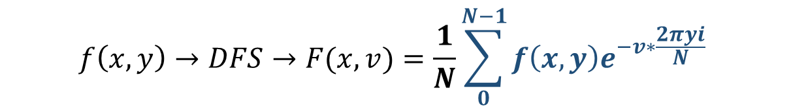
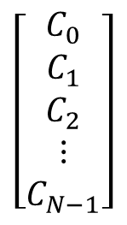
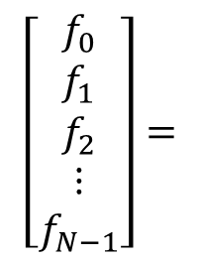
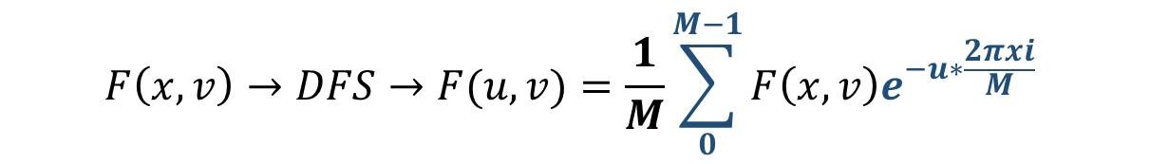
DFT
$$\left[\begin{aligned}f_{0} \\ f_{1} \\ f_{2} \\ ⋮ \\ f_{N−1}\end{aligned}\right]=$$
$$\left[\begin{aligned}C_{0} \\ C_{1} \\ C_{2} \\ ⋮ \\ C_{N−1}\end{aligned}\right]$$
Fourier matrix
The complexity of is high, can be fast?
Generalize to two dimensions:
$$f\left(x,y\right)→DFS→F(x,v)=\frac{1}{N}\sum_{0}^{N−1}{f\left(x,y\right)e^{−v∗\frac{2πyi}{N}} }$$
$$F\left(x,v\right)→DFS→F(u,v)=\frac{1}{M}\sum_{0}^{M−1}{F\left(x,v\right)e^{−u∗\frac{2πxi}{M}} }$$
Notes:
Then this is also very similar with Fourier transform, it is transform fn to Cn. After DFT, Discrete data in function is still discrete.
And we can Generalize to two dimensions: just Do DFT on one dimension and then do transform on the other dimension. But here is a question for DFT, when the period or the time span of the function is very large, it may cost high complexity. So how can be fast?

Slide 12
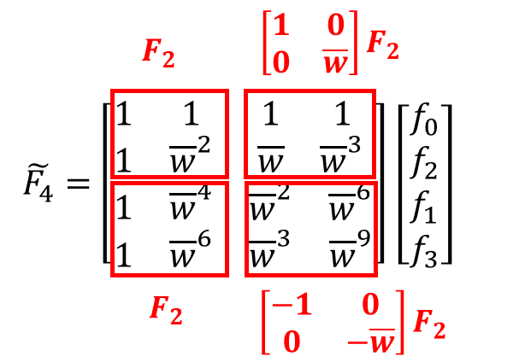

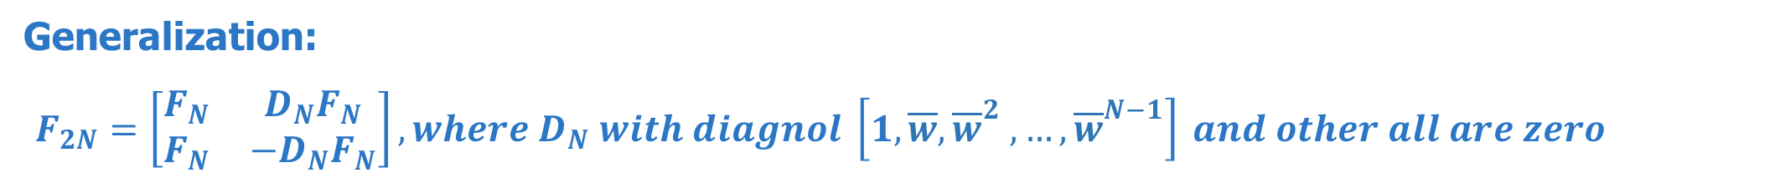

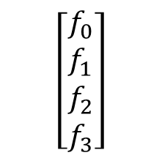
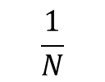
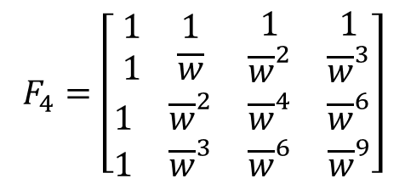
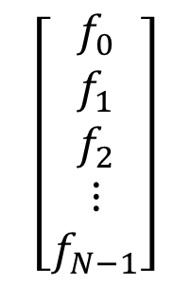
Fast Fourier Transform (FFT)
$$\left[\begin{aligned}f_{0} \\ f_{1} \\ f_{2} \\ ⋮ \\ f_{N−1}\end{aligned}\right]$$
$\overline{ω}:$ conjugate
$$\frac{1}{N}$$
Total Flops is: $2n^{2} –n$
For N=4 as an example:
$$F_{4}=\left[\begin{matrix}\begin{matrix}1 & 1 \\ 1 & \overline{w}\end{matrix} & \begin{matrix}1 & 1 \\ {\overline{w}}^{2} & {\overline{w}}^{3}\end{matrix} \\ \begin{matrix}1 & {\overline{w}}^{2} \\ 1 & {\overline{w}}^{3}\end{matrix} & \begin{matrix}{\overline{w}}^{4} & {\overline{w}}^{6} \\ {\overline{w}}^{6} & {\overline{w}}^{9}\end{matrix}\end{matrix}\right]$$
$$\left[\begin{aligned}f_{0} \\ f_{1} \\ f_{2} \\ f_{3}\end{aligned}\right]$$
Swap
Swap
Generalization:
$F_{2N}=\left[\begin{matrix}F_{N} & D_{N}F_{N} \\ F_{N} & −D_{N}F_{N}\end{matrix}\right], where D_{N} with diagnol \left[1,\overline{w},{\overline{w}}^{2} ,…,{\overline{w}}^{N−1}\right] and other all are zero$
Notes:
So we use some linear algebra skills to solve this, and the new method to transform is called Fast Fourier Transform. First we can analysis the each time inner products. For n rows, there are n square multiplications and n square minus n additions are required. So we should reduce cost by the time of inner product. Just take an example with a 4 times 4 matrix. Swap even and odd columns and the odd and even rows for the f vector. Let the left top part of matrix be f2, according to (conjiu龟), . the other block can also expressed by the f2, here we can also use the complex graph. Then be generalization, every n to the power of two matrix can resolve into the lower.

Slide 13

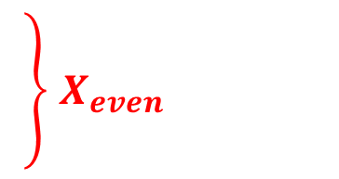
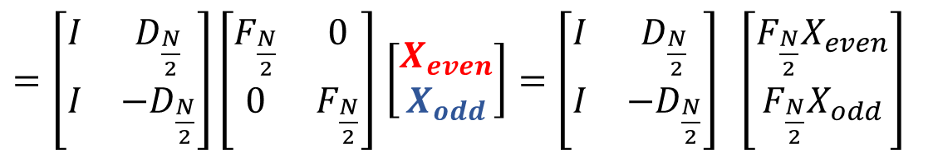
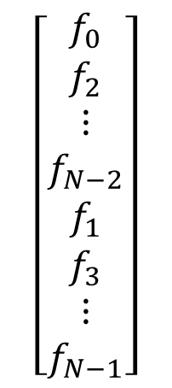
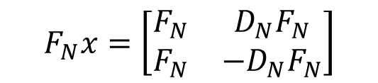
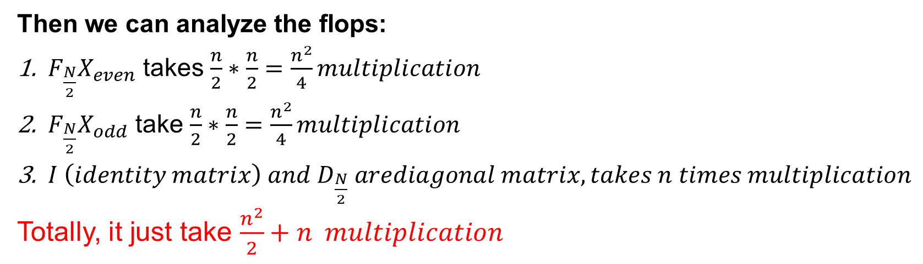
$$\left[\begin{aligned}f_{0} \\ f_{2} \\ ⋮ \\ f_{N−2} \\ f_{1} \\ f_{3} \\ ⋮ \\ f_{N−1}\end{aligned}\right]$$
$X_{even}$
$$F_{N}x=\left[\begin{matrix}F_{N} & D_{N}F_{N} \\ F_{N} & −D_{N}F_{N}\end{matrix}\right]$$
$=\left[\begin{matrix}I & D_{\frac{N}{2}} \\ I & −D_{\frac{N}{2}}\end{matrix}\right]\left[\begin{matrix}F_{\frac{N}{2}} & 0 \\ 0 & F_{\frac{N}{2}}\end{matrix}\right]$ $\left[\begin{aligned}X_{even} \\ X_{odd}\end{aligned}\right]=\left[\begin{matrix}I & D_{\frac{N}{2}} \\ I & −D_{\frac{N}{2}}\end{matrix}\right] \left[\begin{aligned}F_{\frac{N}{2}}X_{even} \\ {F_{\frac{N}{2}}X}_{odd}\end{aligned}\right]$
$X_{odd}$
Then we can analyze the flops:
$F_{\frac{N}{2}}X_{even}$ takes $\frac{n}{2}∗\frac{n}{2}=\frac{n^{2}}{4}multiplication$
${F_{\frac{N}{2}}X}_{odd}$ take $\frac{n}{2}∗\frac{n}{2}=\frac{n^{2}}{4}multiplication$
$I \left(identity matrix\right) and D_{\frac{N}{2}} arediagonal matrix, takes n times multiplication$
Totally, it just take $\frac{n^{2}}{2}+n multiplication$
Notes:
Then the formula can be simplify like this. We can analyze the new flops. Fn except 2 times Xeven and Xodd takes n square divede 2 $multiplication$, and then matrix D and I are the $diagonal matrix,$ so it just take n times multiplication totally, it reduce about half of the products, it will be faster.

Slide 14
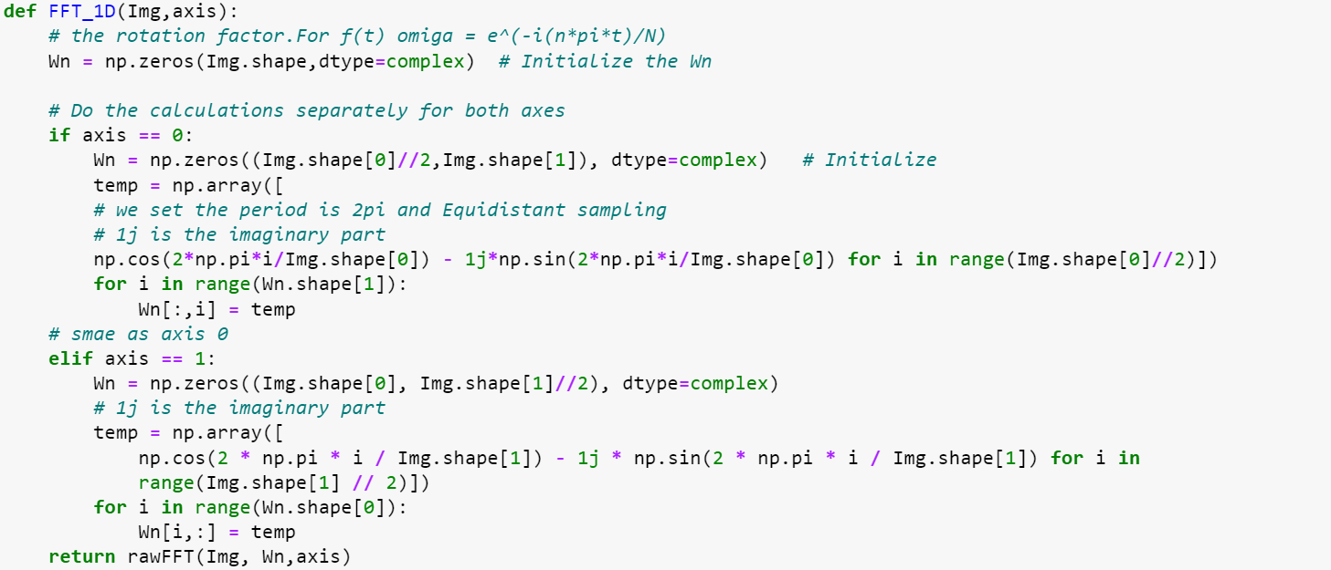
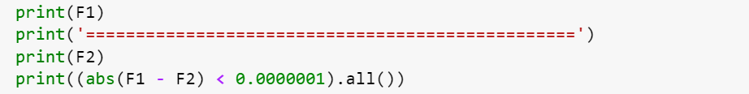


Take a large matrix and you recursively evaluate the submatrices
Notes:
Here is some code of the FFT, There is a FFT 2 dimension function just do the Edge detection and the basic processing. For one dimension function, use to divide two dimension into one dimension FFT. Here we define Sampling frequency. For the FFT function, just like the last page said, first we divide odd and even for the image shape and keep recursion to divide the Fourier matrix and calculate Dn times Fn and I times Fn. When the dimension reduce to the 2 times 2, then we get the basic case and just calculate the result. And you can see at the right hand size, w can get the same result with the package in library. Then welcome to my partner to share some application.

Slide 15

02
PART
An application of FT De-noise of image

Slide 16
2 general kinds of filter for de-noise
Removing noise in space domain
Mean filter
Median filter
Wiener filter
Removing noise in frequency domain
Gaussian lowpass filter
Butterworth lowpass filter

Slide 17

How can we apply filter to color image
3 channels for color image
Filter them respectively
Concatenate them after filtering

Slide 18

Principle of Gaussian lowpass filter
The transfer function for Gaussian lowpass filter
$$H\left(u,v\right)=e^{−D^{2}(u,v)/{2D}_{0}^{2}}$$
$$D_{0}:Cutoff frequency$$
$$D\left(u,v\right):distance to the frequency center$$

Slide 19

Principle of Butterworth lowpass filter
The transfer function for Butterworth lowpass filter
$$H\left(u,v\right)=\frac{1}{(1+{\left(\frac{D\left(u,v\right)}{D_{0}}\right)}^{2n})}$$
$$D_{0}:Cutoff frequency$$
$$D\left(u,v\right):distance to the frequency center$$
$$n:how many times we apply Butterworth filter$$

Slide 20





The choice of the parameter cutoff frequency
De-noise result with different cutoff frequency
$$Cutoff frequency=30$$
$$Cutoff frequency=150$$

Slide 21
03
PART
Result Analysis

Slide 22


Adding the noise
Adding Salt and Pepper noise
Original image

Slide 23

Adding the noise
Original image
Adding Gaussian noise

Slide 24

Adding the noise
Original image
Adding Speckle noise

Slide 25

Peak Signal to Noise Ratio (PSNR)
An objective criterion for evaluating images
The scores may not exactly match the visual quality seen by the human eye
$$PSNR=10×\log_{10}\left(\frac{{\left(2^{n}−1\right)}^{2}}{MSE}\right)$$

Slide 26



Gaussian lowpass filter
Salt and Pepper noise
 | Salt & Pepper Noise | Gaussian Noise | Speckle Noise
PSNR | 24.2529 | 23.5834 | 23.2055
Gaussian noise
Speckle noise

Slide 27



Butterworth lowpass filter
Salt and Pepper noise
 | Salt & Pepper Noise | Gaussian Noise | Speckle Noise
PSNR | 24.2577 | 23.5883 | 23.2104
Gaussian noise
Speckle noise

Slide 28
Future
In practical application, we should make clear that:
the noise type of the image
the degree of influence by noise before processing the noise image
so we can select the appropriate filtering technology and reduce the blindness of image de-noising

Slide 29
Thanks!

Slide 30
References
[1] YANG Li-juan. et al. (2004). Fast Fourier transform and its applications. Opto-Electronic Engineering, 31
[2] NING Yuan. et al. (2005). Analysis and Comparison of Some Techniques on Image Denoising. JOURNAL OF GUIZHOU UNIVERSITY OF TECHNOLOGY(Natural Science Edition), 34(4)
[3] Brigham, E.O.(1988). The fast Fourier transform and its applications. Prentice-Hall, Inc.
[4] Sifuzzaman, M., Islam, M. R., & Ali, M. Z. (2009). Application of wavelet transform and its advantages compared to Fourier transform.

